Slide 1
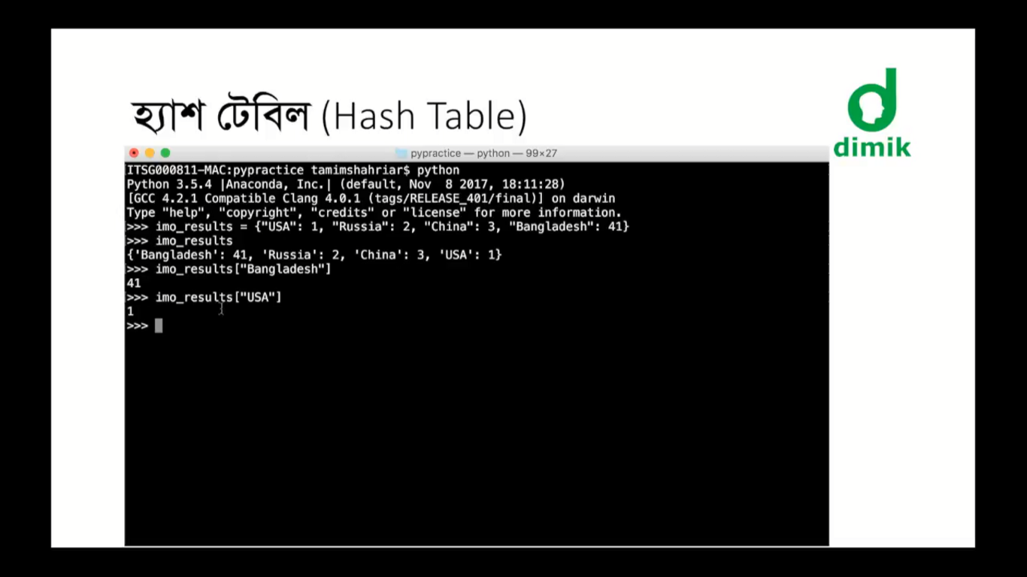

Slide 2
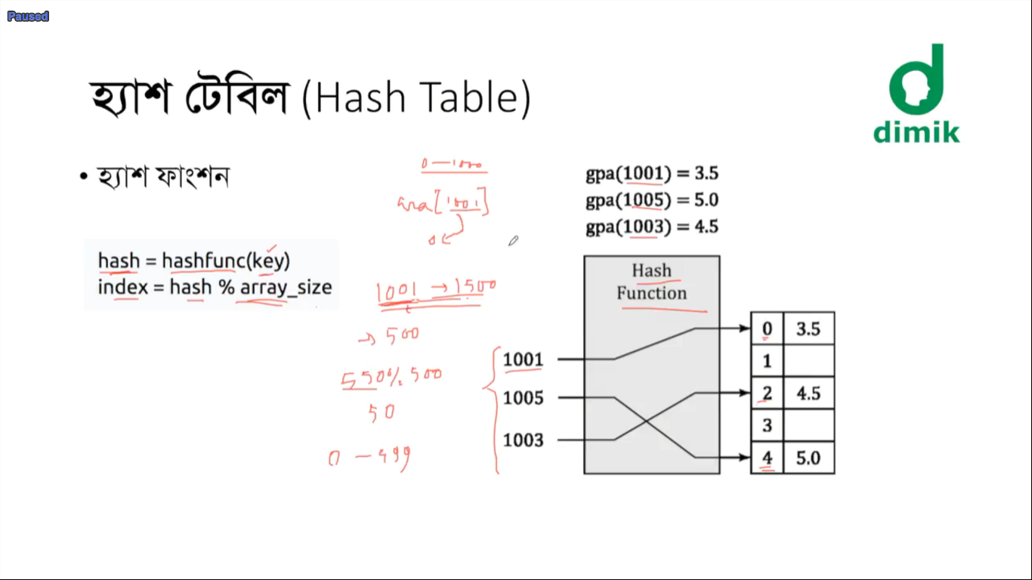

Slide 3
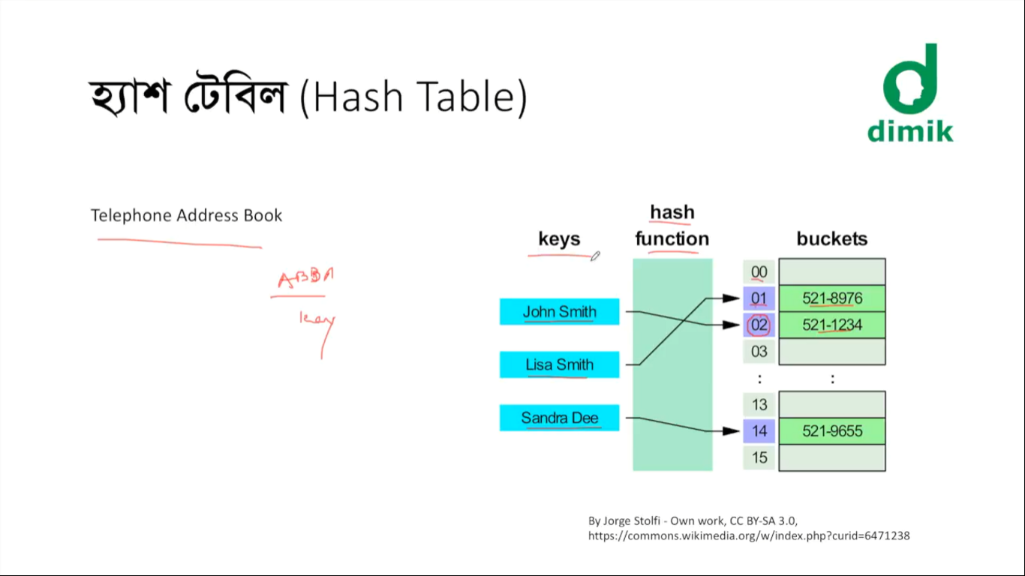

Slide 4
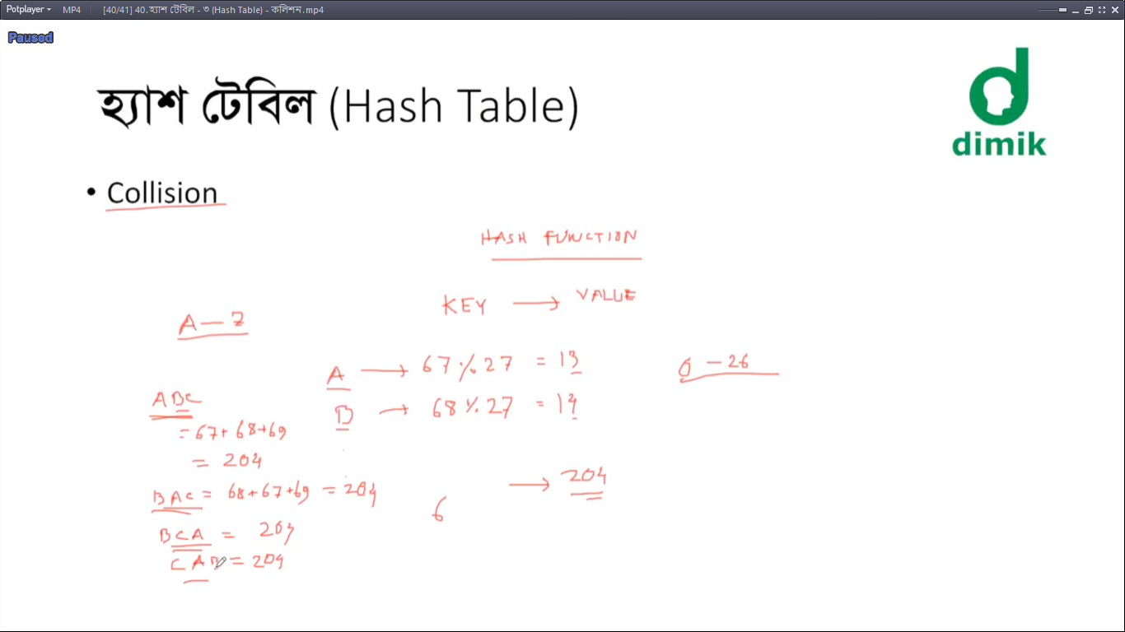

Slide 5
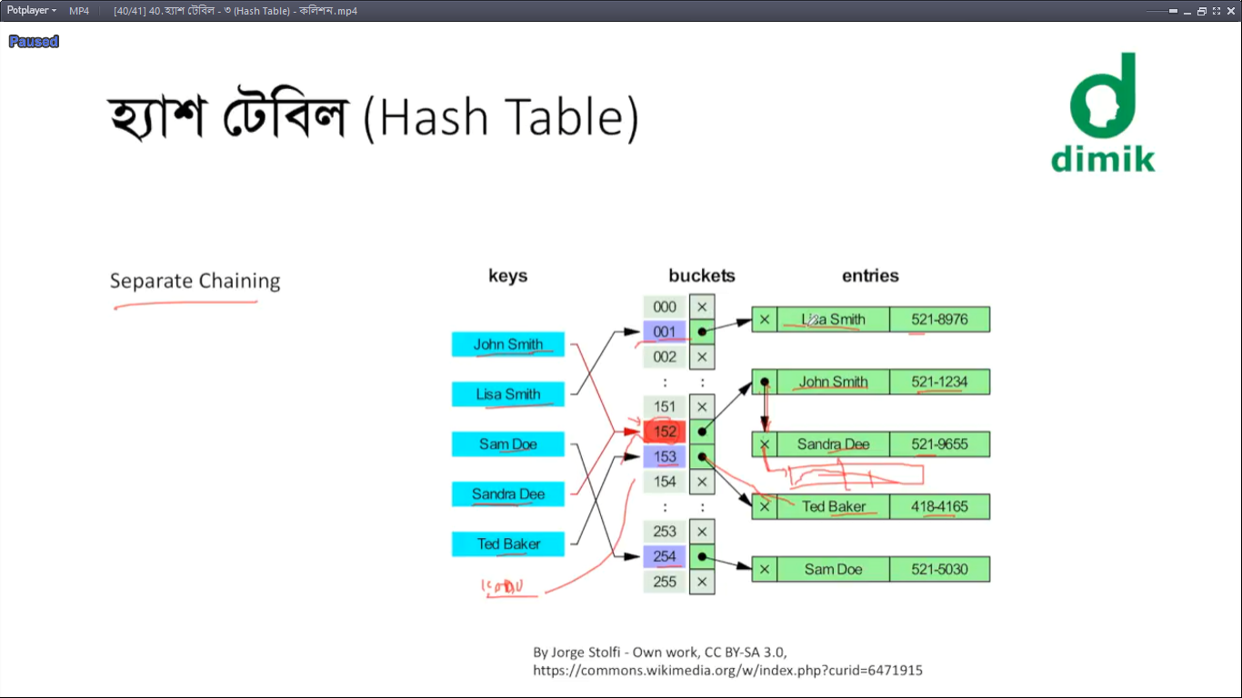

Slide 6
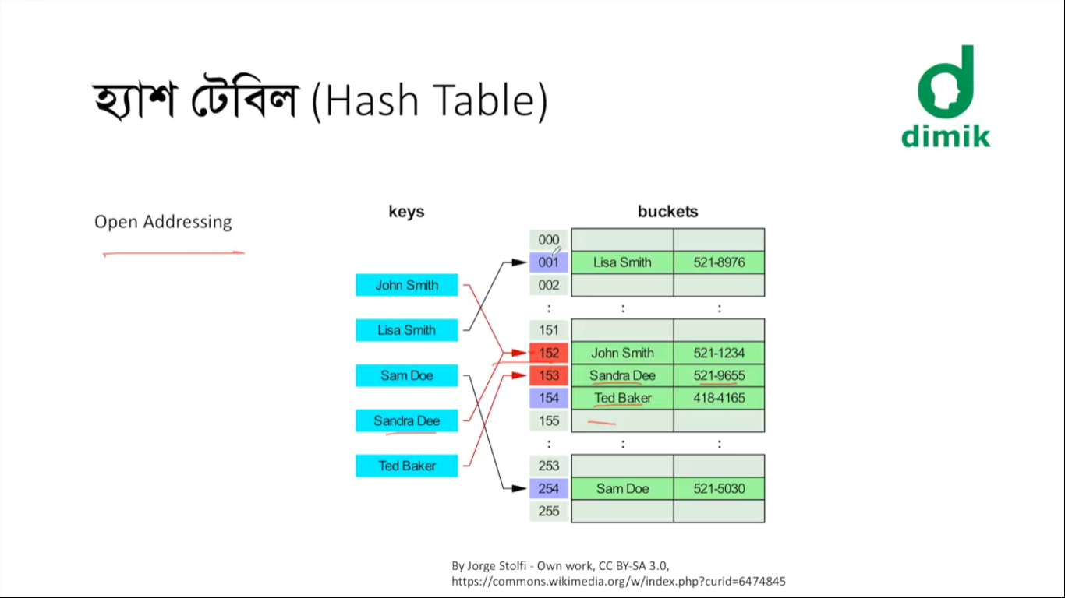
Type of open addressing:
Linear probing
On collusion check the second position of that is empty or not.
Quadric probing
On collusion check the position is empty or not, which is after some period
Double hashing
On collusion, hash again on the hashed result

Slide 7
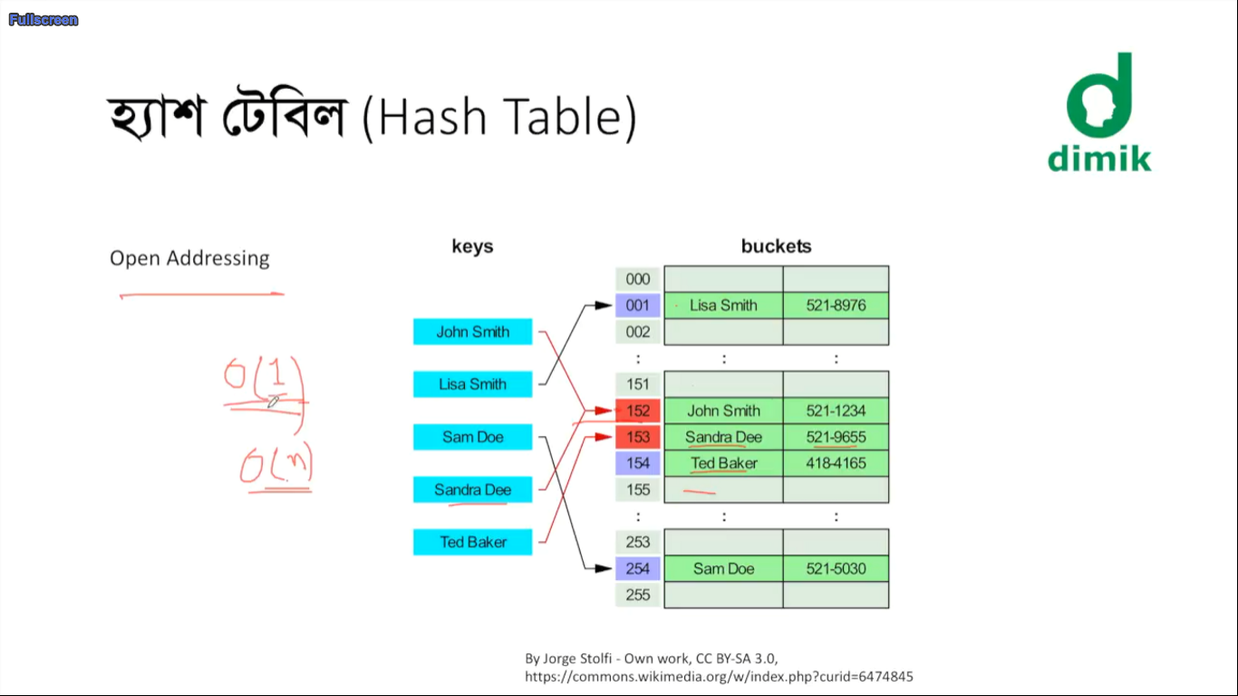
Best & average
case is O(1)
Worst case is O(n),
As we have to do a list searching
to find the data.
(On collusion of every hashed)

Slide 8
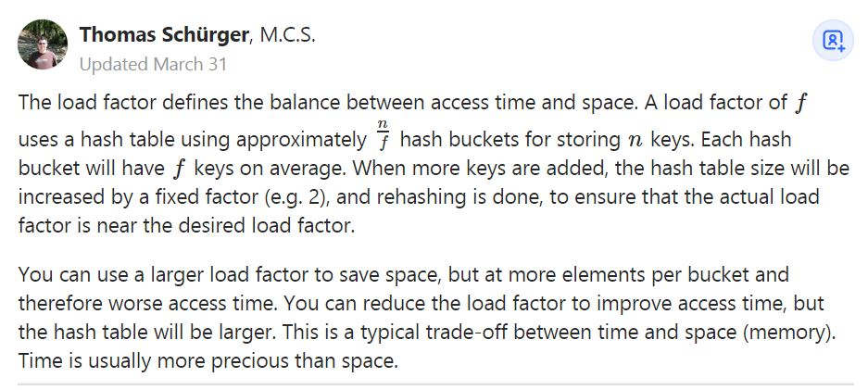
Load factor
(Declaration Size of hash table) / (size of total elements containing in table)

